Slide 1

Azure AZ-104 Resources
Daniel Rey
MCT/MVP
Microsoft 365 Apps and Services

Slide 2
Links (Not everything is Azure-related)
Practice Assessment | Microsoft Learn (DP-900)
Practice Assessment | Microsoft Learn (AZ-900) and Practice Assessment | Microsoft Learn (AI-900)
Practice Assessment | Microsoft Learn (SC-900)
Practice Assessments for Microsoft Certifications | Microsoft Learn (Lots more!)
https://azure.microsoft.com/en-us/products/azure-modular-datacenter/#features
Have I Been Pwned | Microsoft Docs
https://informationisbeautiful.net/visualizations/worlds-biggest-data-breaches-hacks/
https://docs.microsoft.com/en-us/events/ignite-mar-2021/azure/sessions/od343/ (2021) https://www.youtube.com/watch?v=-GUQU8iYy8Y (2022)
https://docs.microsoft.com/en-us/office/developer-program/microsoft-365-developer-program-faq
https://www.rupeshtiwari.com/azure-update-domain-vs-fault-domain/
https://azure.microsoft.com/en-us/support/legal/sla/virtual-machines/v1_9/
https://support.microsoft.com/en-us/office/what-does-it-mean-when-your-onedrive-account-is-frozen-5e76147b-b7d5-4bcb-ba28-b91e3eb636b6
https://docs.microsoft.com/en-us/azure/active-directory/roles/security-emergency-access
The whole HP wolf security hacker man saga - YouTube
https://github.com/stilldrey (this will be up there)
https://www.linkedin.com/video/golive/now/ - setup LinkedIn Live (Azure location is a choice from this page)

Slide 3
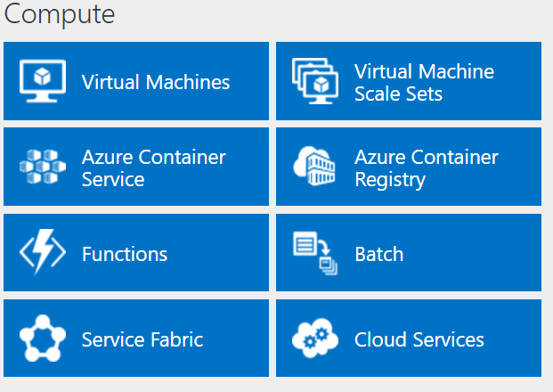
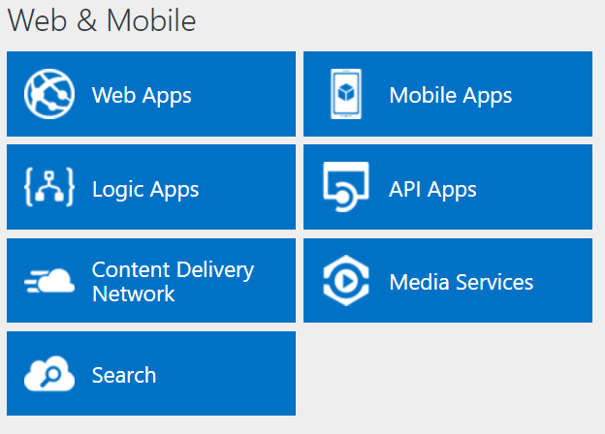
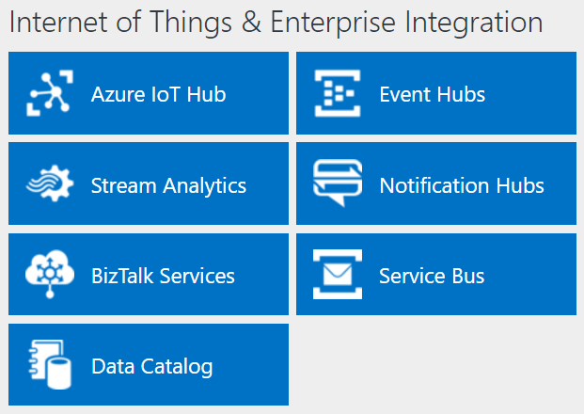
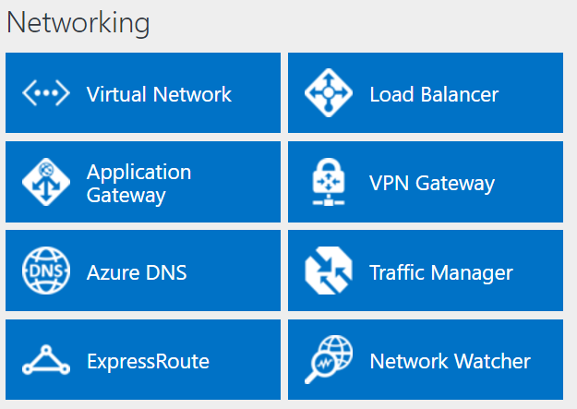
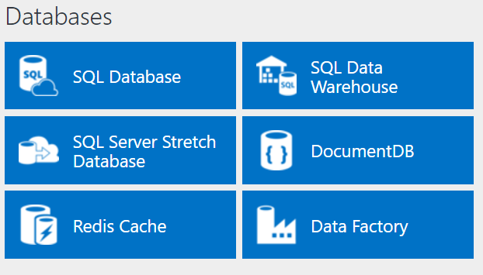
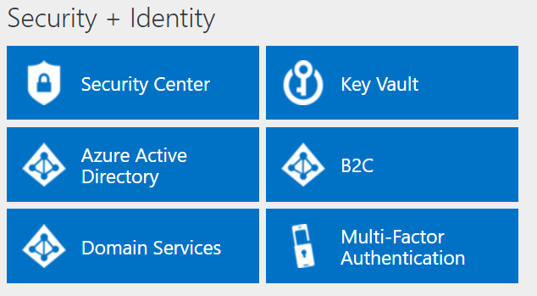
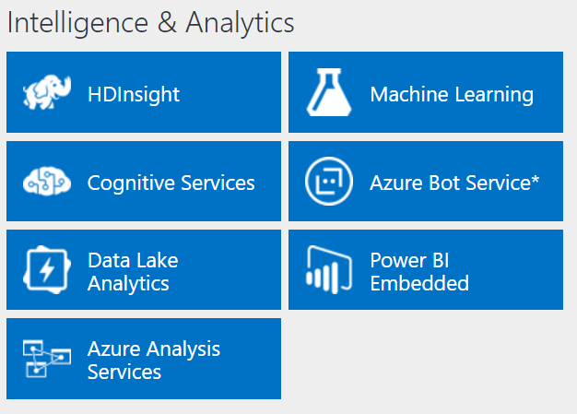
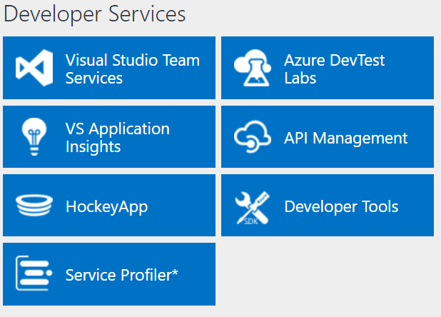
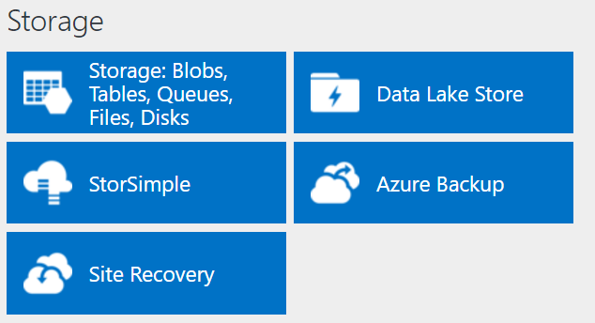
http://azureplatform.azurewebsites.net/
As of 2017
Directory of Azure Cloud Services | Microsoft Azure current
* Preview Services
Notes:
Preview Version 1.7 (2017-04-20)
azure platform site:azurewebsites.net - Search (bing.com)
Directory of Azure Cloud Services | Microsoft Azure

Slide 4
More Resources
Project Natick Project Natick Phase 2 (microsoft.com)
Azure Modular Datacenter | Microsoft Azure
The Azure Infrastructure Architect Map - Microsoft Tech Community
Azure Products by Region | Microsoft Azure
List of Azure services the Azure CLI can manage | Microsoft Docs
History of Microsoft Azure

Slide 5
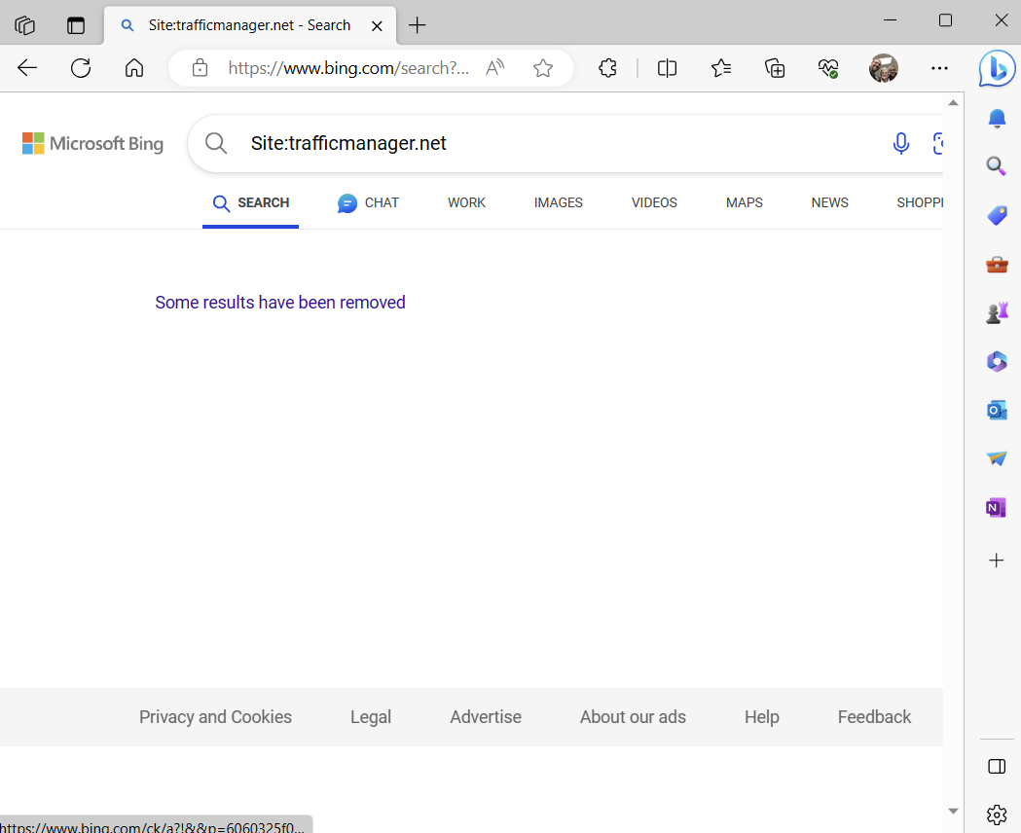
















TIP: List all the trafficmanager.net sites (global) removed from BING!

Slide 6
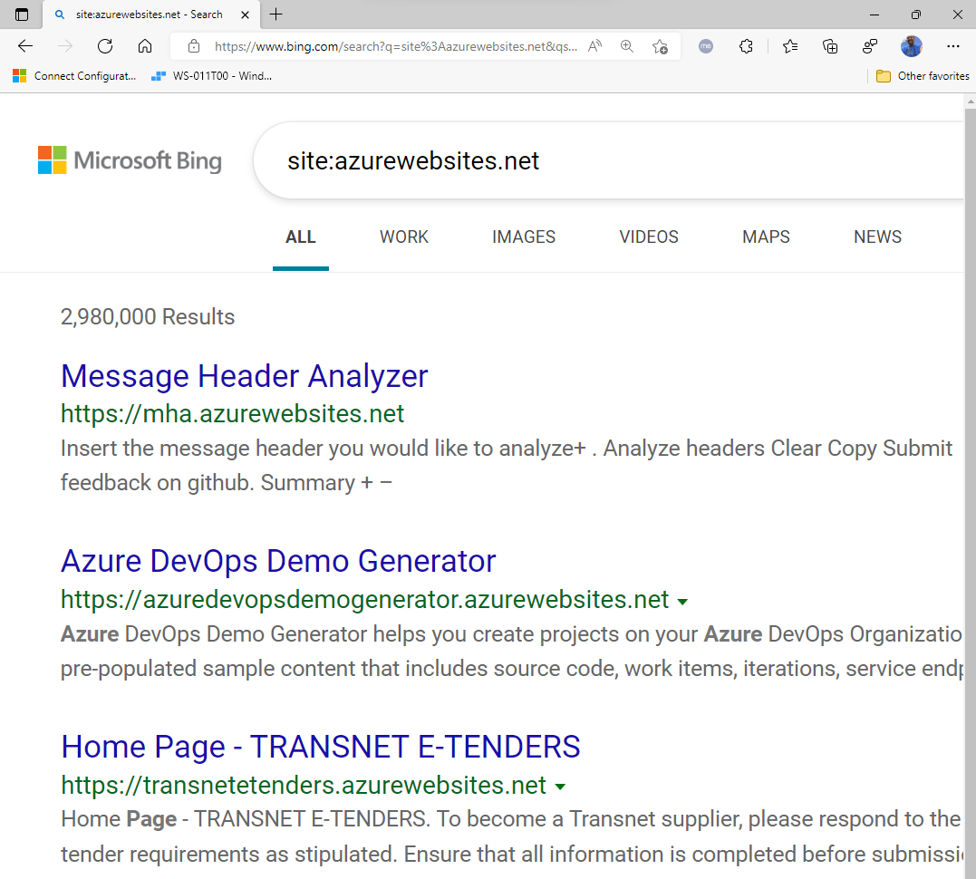
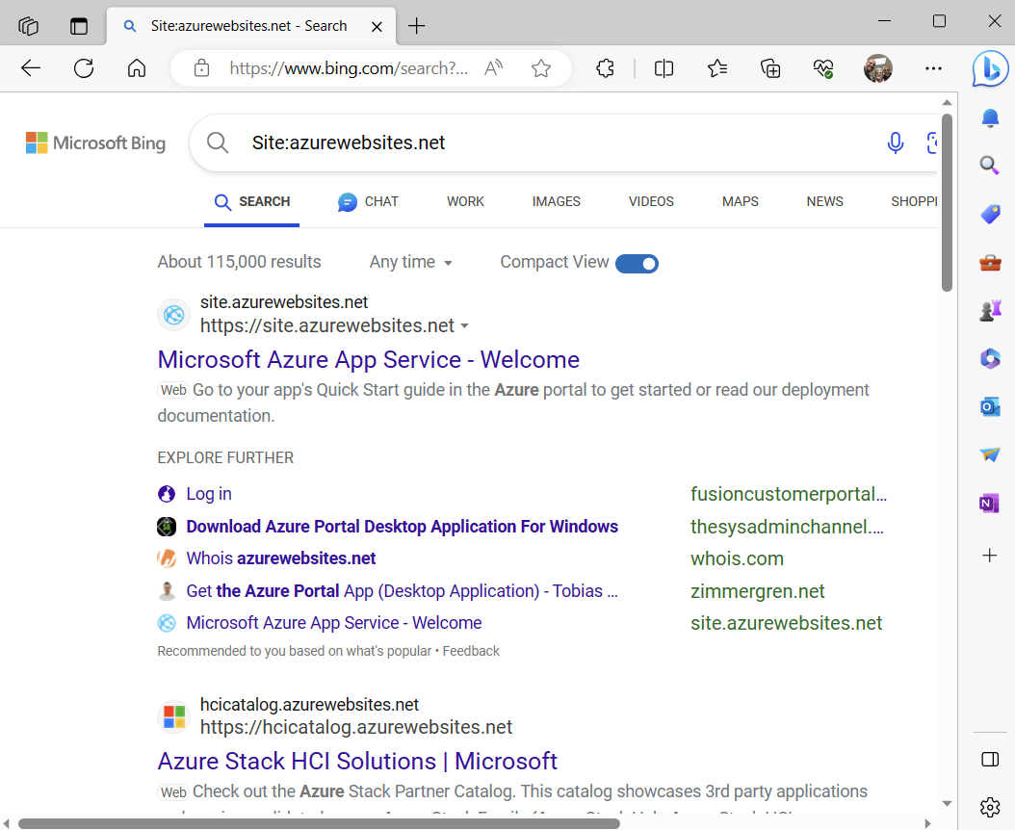
Tip: site:azurewebsites.net search in bing or google

Slide 7
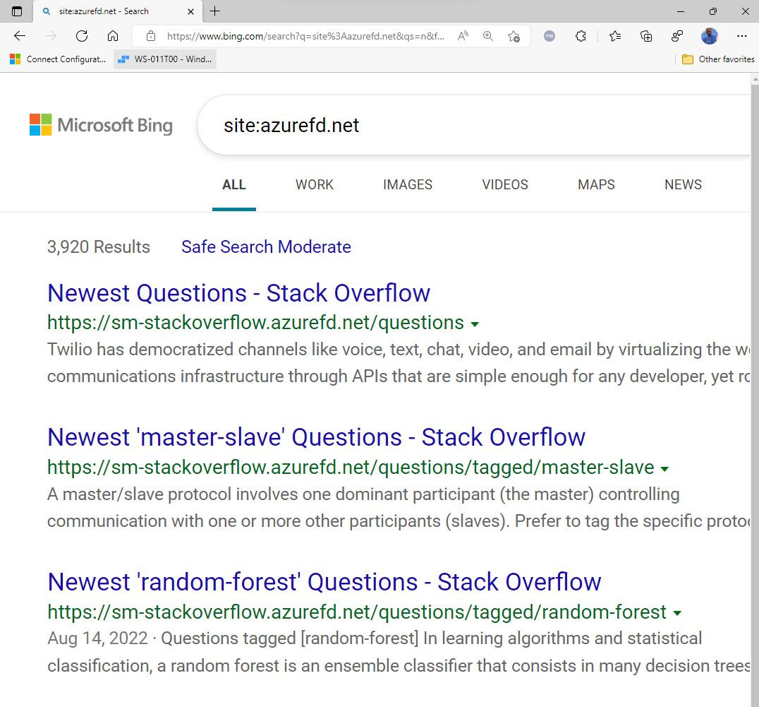
Same tip with azurefd.net (azure front door websites)
LinkedIn is moving to Microsoft Azure three years after acquisition (cnbc.com)
Accelerating the LinkedIn Experience with Azure Front Door | LinkedIn Engineering

Slide 8
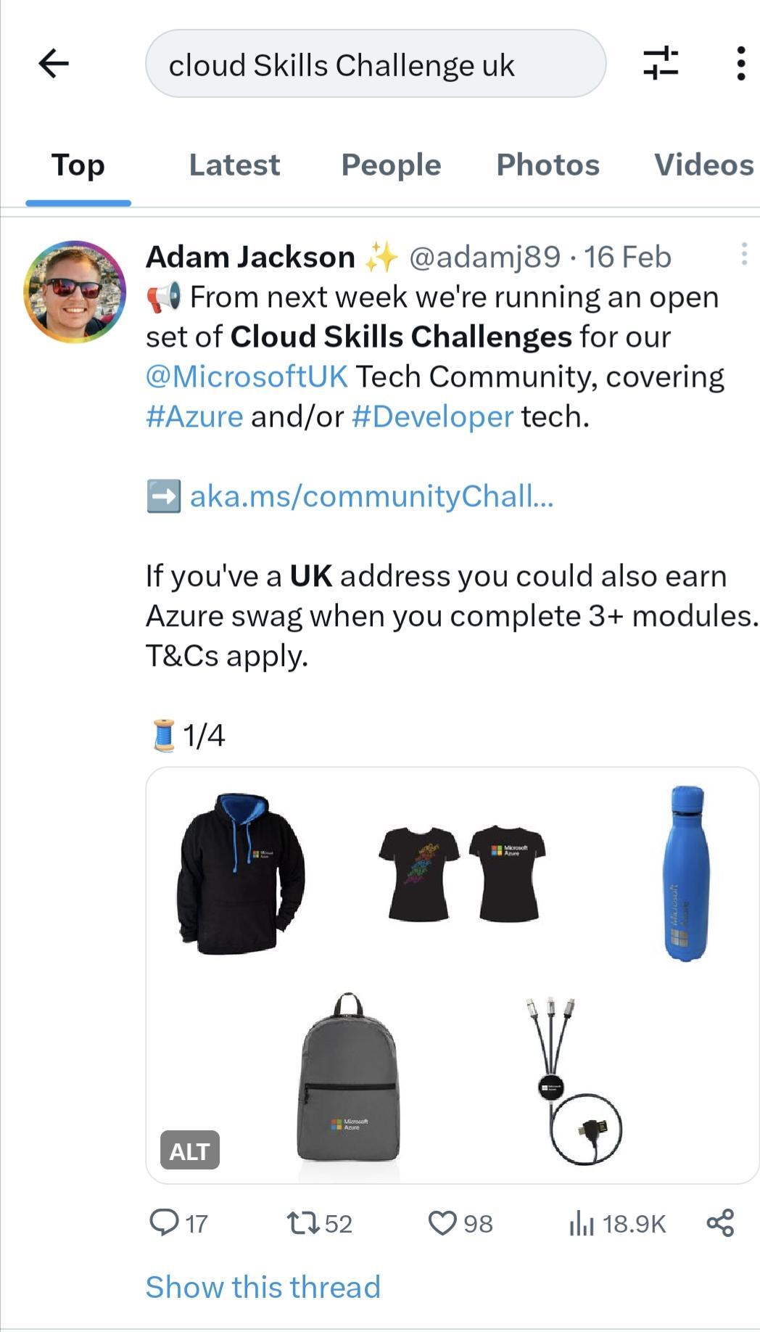
March 2023 update!
Cloud Skills Challenge (UK residents have swag available!!!) https://twitter.com/adamj89/status/1626155400713191425?t=2rVyK6L7J_DE_o3raoVu9g&s=19
https://youtu.be/tQp1YkB2Tgs John Savills
Technical Training

Slide 9
July 2023 Update
(597) Containerization Explained – YouTube (IBM)
https://www.youtube.com/watch?v=cjXI-yxqGTI (Containers vs VMs)
https://www.youtube.com/watch?v=daVUONZqn88 (Azure K8s)
https://www.youtube.com/watch?v=PH-2FfFD2PU (K8s VMWare)

Slide 10
1 Administer Identity
Notes and Resources

Slide 11
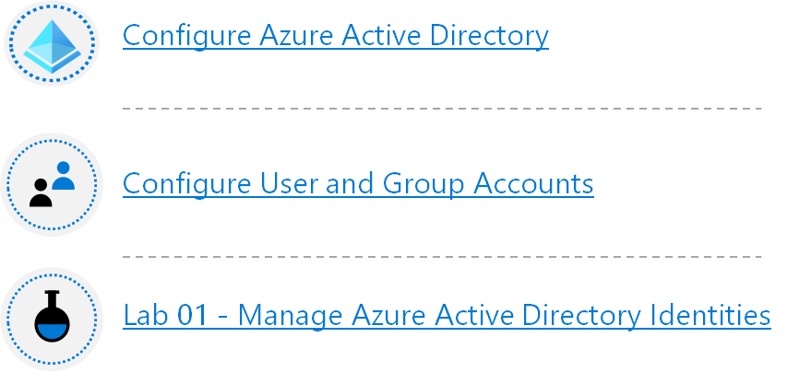
Module 1
Allow users to reset their password with Azure Active Directory self-service password reset (Sandbox)
Manage device identity with Azure AD join and Enterprise State Roaming
Implement and manage hybrid identity
Create Azure users and groups in Azure Active Directory (Sandbox)
Manage users and groups in Azure Active Directory

Slide 12
Administer Governance and Compliance
Notes and Resources

Slide 13


Module 2
Configure Subscriptions
Configure Azure Policy
Configure Role-Based Access Control
Lab 02a - Manage Subscriptions and RBAC
Lab 02b - Manage Governance via Azure Policy
Lab 03a – Manage Azure resources with the Azure portal

Slide 14
Administer Azure Resources

Slide 15
Module 3
Configure Azure Resources with Tools
Configure Resources with ARM Templates
Lab 03b - Manage Azure resources by Using ARM Templates
Lab 03c - Manage Azure resources by Using Azure PowerShell (optional)
Lab 03d - Manage Azure resources by Using Azure CLI (optional)

Slide 16
Administer Virtual Networking
Notes and Resources

Slide 17
Module 4
Secure and isolate access to Azure resources by using network security groups and service endpoints (Sandbox)
Introduction to Azure Firewall
Design an IP addressing schema for your Azure deployment (Sandbox)
Introduction to Azure Firewall Manager
Implement Windows Server IaaS VM IP addressing and routing
Host your domain on Azure DNS (Sandbox)
Introduction to Azure Virtual Networks
Implement DNS for Windows Server IaaS VMs

Slide 18
Administer Intersite Connectivity
Notes and Resources

Slide 19
Module 5
Configure VNet Peering
Configure VPN Gateway (Optional)
Configure ExpressRoute and Virtual WAN (Optional)
Lab 05 - Implement Intersite Connectivity

Slide 20
Administer Network Traffic
Notes and Resources

Slide 21



Module 6
Configure Network Routing and Endpoints
Configure Azure Load Balancer
Configure Application Gateway
Configure Network Watcher
Lab 06 – Implement Traffic Management

Slide 22
Administer Azure Storage
Notes and Resources

Slide 23
Module 7
Configure Storage Accounts
Configure Blob Storage
Configure Storage Security
Configure Azure Files and File Sync
Lab 07 – Manage Azure Storage

Slide 24
Administer Azure Virtual Machines
Notes and Resources

Slide 25
Module 8
Configure Virtual Machines
Configure Virtual Machine Availability
Configure Virtual Machine Extensions
Lab 08 – Manage Virtual Machines

Slide 26
Administer PaaS Compute Options
Notes and Resources

Slide 27




Module 9
Configure Azure App Service Plans
Configure Azure App Services
Configure Azure Container Instances
Configure Azure Kubernetes Service
Lab 09a - Implement Web Apps
Lab 09b - Implement Azure Container Instances
Lab 09c - Implement Azure Kubernetes Service (optional)

Slide 28
Administer Data Protection
Notes and Resources

Slide 29


Module 10
Configure File and Folder Backups
Configure Virtual Machine Backups
Lab 10 – Implement Data Protection

Slide 30
Administer Monitoring
Notes and Resources

Slide 31



Module 11
Configure Azure Monitor
Configure Azure Alerts
Configure Log Analytics
Lab 11 – Implement Monitoring

Slide 32
More to come!

